Slide 1
Schedulers
Schedulers are special system software which handle process scheduling in various ways. Their main task is to select the jobs to be submitted into the system and to decide which process to run. Schedulers are of three types
Long-Term Scheduler
Short-Term Scheduler
Medium-Term Scheduler

Slide 2
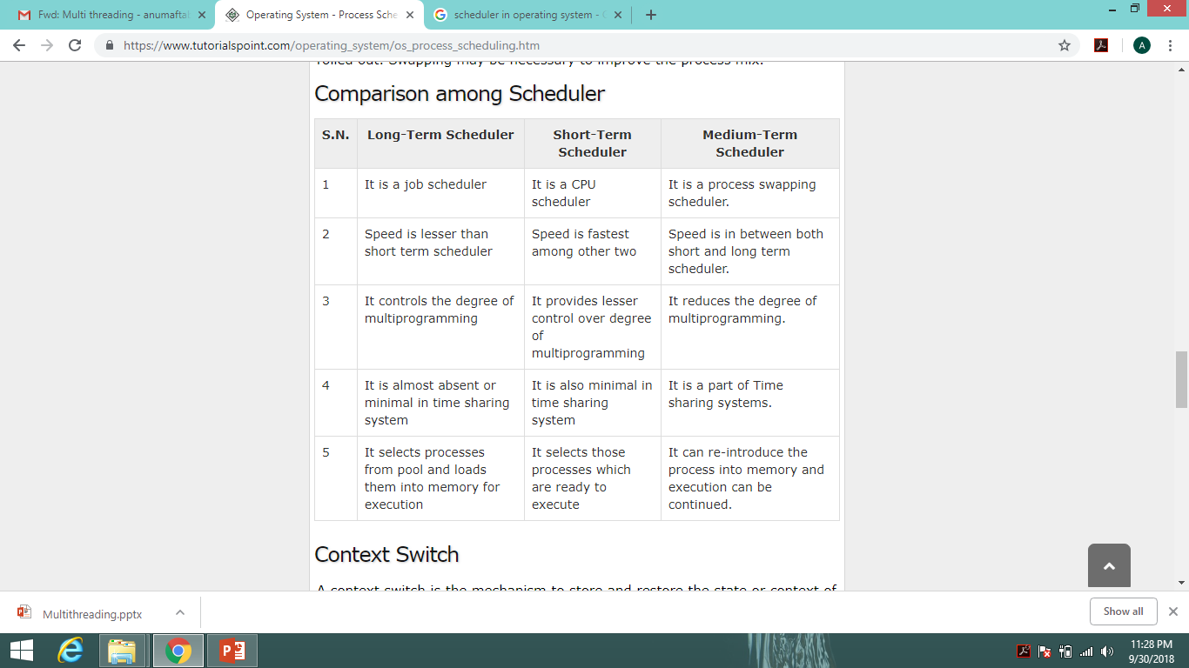

Slide 3
Context Switch
A context switch is the mechanism to store and restore the state or context of a CPU in Process Control block so that a process execution can be resumed from the same point at a later time. Using this technique, a context switcher enables multiple processes to share a single CPU. Context switching is an essential part of a multitasking operating system features.
When the scheduler switches the CPU from executing one process to execute another, the state from the current running process is stored into the process control block. After this, the state for the process to run next is loaded from its own PCB and used to set the PC, registers, etc. At that point, the second process can start executing.

Slide 4
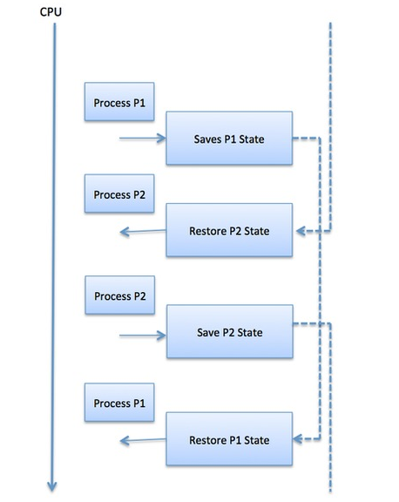
Context switches are computationally intensive since register
and memory state must be saved and restored. To avoid the
amount of context switching time, some hardware systems
employ two or more sets of processor registers.
When the process is switched, the following information is
stored for later use.
Program Counter
Scheduling information
Base and limit register value
Currently used register
Changed State
I/O State information
Accounting information

Slide 5
Multithreading

Slide 6
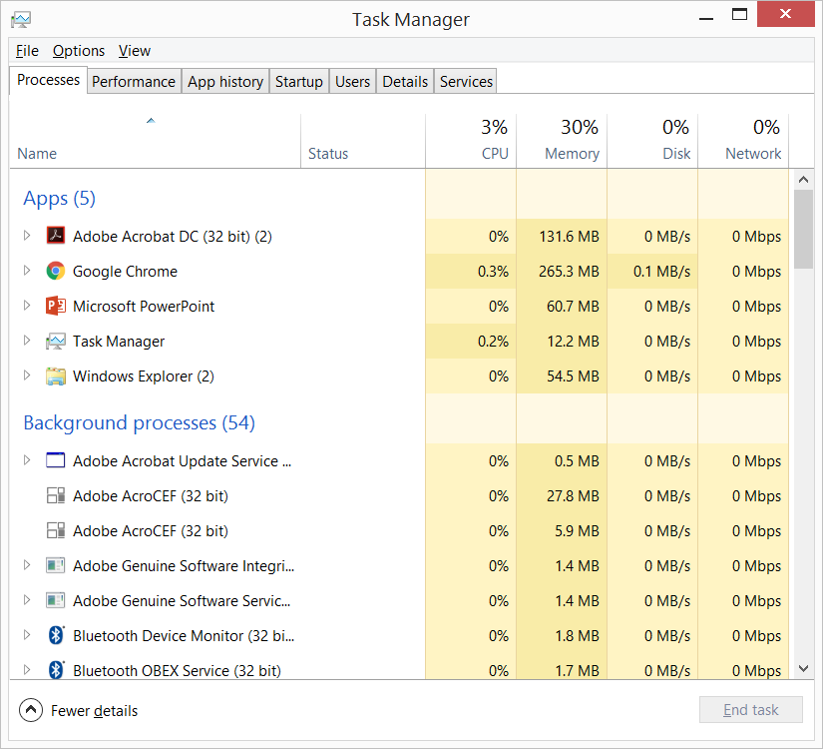
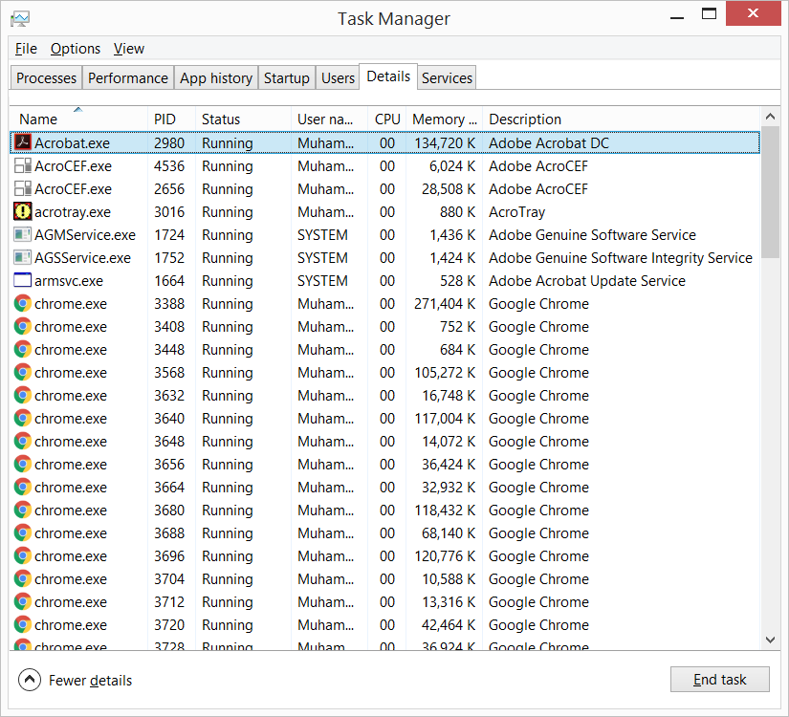
Multitasking
Process-based
Thread-based

Slide 7
Multitasking
Process Based | Thread Based
Execute two or more programs concurrently | Single program can perform two or more tasks simultaneously
Program is the smallest peace of unit that can be dispatched by the scheduler | Thread is the smallest peace of unit dispatchable code.
Big picture | Inner details
Processes are heavy weight tasks that require their own address space | Lighter weight and share same address space
Inter process communication is expensive | Inter thread communication is inexpensive
Context switching is costly | Context switching from one thread to other is lower in cost
 | Less overhead

Slide 8
Java - Multithreading
Java provides built-in support for Multithreading
The Java run-time system depends on threads for many things
All the class libraries are designed with multithreading in mind.
Java uses threads to enable the entire environment to be asynchronous.
  Reduce inefficiency by preventing the waste of CPU cycles.

Slide 9
Thread States
Running
Ready to Run
  Waiting for CPU time
Suspended
  Temporarily halts its activity
Resumed
  Picking up from where it left
Blocked
  Waiting for a resourse
Terminated
  At any time
  Cannot be resumed

Slide 10
Thread Priorities
Integers that specify the relative priority
How a thread is treated with respect to other threads
Higher-priority thread doesn’t run any faster than a lower-priority thread if it is the only thread running
To decide when to switch from one running thread to the next
Context Switch
  voluntarily relinquish control
  preemptive multitasking
Two thread with the same priority ?
  Windows: time sliced in round robin
  Some other operating systems: voluntarily relinquish control for peer thread with same priority value

Slide 11
Java basic concepts to understand this implementation
Class
Object
Reference
Constructor
Methods
Static
Public
Abstract class
Interface

Slide 12
Java’s Multithreading Module
Thread class
Runnable interface
To create a new thread either extend the Thread class or implement Runnable interface

Slide 13
Main thread
When a program starts up (in Java), main thread begins running immediately.
  Other child threads spawn from this main thread
  It is the last to finish
    Because it has many shutdown actions
Can be controlled through a Thread object
currentThread(): returns a reference to the thread in which it is called

Slide 14
Controlling the main thread – Java Example
// Controlling the main Thread.
class CurrentThreadDemo {
public static void main(String args[]) {
Thread t = Thread.currentThread(); //Getting the reference of current thread
System.out.println("Current thread: " + t);
// change the name of the thread
t.setName("My Thread");
System.out.println("After name change: " + t); // printing new name of thread
try {
for(int n = 5; n > 0; n--) {
System.out.println(n);
Thread.sleep(1000);
}
}
catch (InterruptedException e) {
System.out.println("Main thread interrupted");
}
}
}

Slide 15
Implementing Runnable
class NewThread implements Runnable {
Thread t;
NewThread() {
t = new Thread(this, "Demo Thread"); // for other constructors and their details https://docs.oracle.com/javase/7/docs/api/java/lang/Thread.html
System.out.println("Child thread: " + t);
t.start(); // Start the thread
}
public void run() {
try {
for(int i = 5; i > 0; i--) {
System.out.println("Child Thread: " + i);
Thread.sleep(500);
}
} catch (InterruptedException e) {
System.out.println("Child interrupted.");
}
System.out.println("Exiting child thread.");
}
}

Slide 16
Implementing Runnable
class ThreadDemo {
public static void main(String args[ ] ) {
new NewThread(); // create a new thread
try {
for(int i = 5; i > 0; i--) {
System.out.println("Main Thread: " + i);
Thread.sleep(1000);
}
} catch (InterruptedException e) {
System.out.println("Main thread interrupted.");
}
System.out.println("Main thread exiting.");
}
}

